Slide 1
Estates Programme
Strategic Police & Crime Board
Private meeting
9th January 2018

Slide 2
Estates Programme
Background
Building on the foundations of the 2012 Estates Strategy and the creation of the NWOW brand together with new estates solutions (Lloyd House, Central & Western Custody and Bloxwich), WMP can now start to develop the remaining force estate in line with the new NWoW standards of modern, flexible and agile accommodation to support the delivery of WMP services.
The programme will support the delivery of a flexible and responsive police service, integrate more effectively with partners and provide a modern, agile estate that WMP’s workforce feel pride in. The end state solution meets these ambitions in a way that will secure a more sustainable and efficient future, and supports the maintenance of strong links with the local community.
It is proposed that the changes are expected to result in:
Reduction in WMP’s outgoings on estates seeing a reduction of ~£5m
Reducing exposure backlog maintenance by £20m
Generating capital receipts of £44m

Slide 3
Estates Programme
Evolution & current state
Rationalisation Project identified 35 buildings for disposal (inc. Walsall 6 & Old Hill) ~12 left to dispose
Refurbishing WMP Headquarters and the Introduction of NWoW principles providing a more modern, flexible and agile estate enabled the release of costly city centre leasehold properties saving WMP £4.1m
100+ premises remaining on the WMP property portfolio
Poor standards of accommodation, current £20m backlog maintenance outstanding
Addressing the backlog maintenance will only provide a basic level of accommodation NOT NWoW standard
Outdated and not fit for purpose - £20m outstanding backlog maintenance
Not necessarily the right size or right location – doesn’t allow for business change
Made up of accommodation that cannot be easily upgraded
For circa. 5years only H&S issues addressed within the estate with the exception of NWoW Programme and New Build Custody

Slide 4
Estates Programme
How can we improve
We know Lloyd House and Bloxwich work
Introduction of Eastern Custody block as we know this model works
Programme of change to reduce the estates foot print from ~173,000 m² to ~133,000 m² bringing WMP generic office space ratio more in line with industry standards to 8:10
Provide a modern and flexible estate portfolio that supports operational policing
Release of prime residential land to enable the development of housing in communities
Release of properties that can be utilised within the community
Increased opportunity to develop partnership working with local authorities and other public bodies
A more efficient estate in line with corporate and social responsibility

Slide 5
Estates Programme
High level outcomes
The Estates Programme will deliver:
A transformed WMP estates within 6 years to meet the requirements of the WMP2020 model
Resilient accommodation that enables business continuity and keeps our people and assets secure
Facilitate the rapid deployment of police resources on a 24/7 basis across the entire force area
Futureproof estate with increased flexibility to respond to changing requirements
Reduction in annual revenue spend through the reduction of backlog maintenance
Increased space utilisation, occupational density, and agility; potentially increasing NIA/GIA ratio
Co-location with partners, achieving a greater collaboration and sharing of physical assets
Embedded NWOW standards in all WMP estate

Slide 6
Estates Programme
Indicative benefits
The benefits will be defined through the Business Case which are outlined as:
Reduced revenue spend on excess estate by £5m pa (equates to 102 Police Officers or 168 PCSO’s)
One-off revenue saving of c £20m through the removal of back-log maintenance liability
Reduction in overall Carbon footprint (energy consumption)
Capital receipts through the sale of freehold properties
Increased employee satisfaction through alignment with the People Deal
Increased integration with partners through co-location opportunities
Increased business efficiencies through the introduction of NWoW technology, agility principles and guidelines

Slide 7
Estates Programme Target operating model
Current
Target
WMP total estates footprint ~c173,000m² within the WMP Property Portfolio
Reduction in estates footprint by c.20% (to c138,000 m² from c173,000 m² ) through the rationalisation of the current estates portfolio (inc. property disposals)
Poor standards of accommodation with £20m backlog maintenance outstanding
Rationalised Estate brought up to NWoW standards, eradicating the backlog
Varying standards of office space and shared spaces throughout the estate
Generic office space ratio more in line with industry standards to 8:10, NWoW standards for office, storage, welfare and shared spaces (inc. lockers)
Varying NWoW standards of agility and technology force wide
Consistent NWoW technologies and working practices force wide enabling and supporting an agile workforce
Neighbourhood resources located predominantly within WMP estate. In many cases small m² requirement in large otherwise empty buildings
Co-location of c50% Neighbourhood resources into partner owned buildings supporting greater partnership working
Public Contact Offices comprising of 10 locations force wide
Public Contact Office model comprising of 10 locations force wide
(re-provisioned where required)
Force Response comprising of 10 hubs
New Force Response model comprising of 6 hubs
Custody block model comprising of 6 blocks and 2 resilience sites
New custody block model comprising of 4 blocks which includes 1 new block on the East incorporating TACT and 2 resilience sites

Slide 8
Estates Programme Target operating model
Current
Target
Current ECS limitations in its capacity and capability to support planned and unplanned large events
A new ECS with greater capacity and capability on WMP owned estate tested and proven to be operational in advance of 2022 Commonwealth Games
L&D provision predominantly centrally based in poor accommodation with limited force wide service delivery
An estate that satisfies the agreed Operational Learning Review which may incorporate fit for purpose learning environments within multi-functional rooms across the estate
Centrally based PPU service delivery from a poorly laid out shared building with limited capacity for growth or storage
Provision of a fit for purpose working environment for sensitive investigations that will enable officers to provide professional support to vulnerable victims
Forensics currently located at various sites with a poorly laid out main site
Main site will be redeveloped; creating a forensics hub and enabling the function to vacate other sites
Ineffective and disparate detained property and records management processes, that impact on operational service delivery
Create a Logistics Hub for key services, including Fleet, IT&D storage, Facilities, centrally based detained property and records management
Operations are currently located at a number of sites impacting on operational tasking and resilience
Operations’ functions to be centralised
ROCU currently housed in temporary accommodation and/or compromised covert locations, need a long term fit for purpose solution
ROCU to exit current locations and co-locate functions that naturally align with ROCU (i.e. CCU). Covert elements to be accommodated in leasehold property

Slide 9
Estates Programme Hot Topics
Solihull
Re-provisioning with Partners
Commonwealth Games
Sutton Coldfield
Resources for delivery

Slide 10
Estates Programme End state solution - Retain
LPU | Property Name | Future state
BE | Moseley | NWoW
BE | Stechford | NWoW
HQ | Central Lock-Up | NWoW
HQ | Ladywood | NWoW
HQ | Ridgepoint House | NWoW
SH | Chelmsley Wood | NWoW
SW | West Bromwich | NWoW
WV | Wolverhampton Central | NWoW
CTU | Artemis Court | Retain 'as is'
CTU | Birmingham Int' - Diamond House | Retain 'as is'
CTU | Elmdon Trading Estate | Retain 'as is'
CTU | Gravelly Industrial Park (Unit 81) | Retain 'as is'
HQ | Central Custody Suite | Retain 'as is'
HQ | CMPG Motorway (Quinton) | Retain 'as is'
HQ | CMPG Perry Barr | Retain 'as is'
HQ | Lloyd House | Retain 'as is'
HQ | Newton Street (Coroner's Office) | Retain 'as is'
HQ | RAF Cosford | Retain 'as is'
HQ | Western (Oldbury) Custody Suite | Retain 'as is'
Ops | Centro House - Safer Travel | Retain 'as is'
WS | Bloxwich | Retain 'as is'
WS | Walsall Civic Centre | Retain 'as is'
LPU | Property Name | Future state
BW | Bournville | New build
CTU | Willenhall (Coventry South) TACT | New build
DY | Brierley Hill | New build
BE | Erdington | Re-build
BW | Newtown | Re-build
CV | Coventry Central | Re-build
HQ | Bradford Street | Re-build
HQ | Aston | Re-build
Ops | Park Lane site | Re-build
BW | Summerfield Police Station | Enhancement
CV | Bell Green | Enhancement
Ops | Dog Training Centre | Enhancement
SH | Winchcombe Road | Enhancement
WV | Low Hill Sector | Enhancement
WV | Bilston | Enhancement

Slide 11
Estates Programme End state solution – Sell & re-provision
LPU | Property Name | Future state
BE | Acocks Green | Sell & re-provision
BE | Balsall Heath | Sell & re-provision
BE | Shard End | Sell & re-provision
BE | Sutton Coldfield inc. Annexe | Sell & re-provision
BW | Kingstanding | Sell & re-provision
BW | Harborne | Sell & re-provision
BW | Quinton | Sell & re-provision
BW | Digbeth | Sell & re-provision
BW | Handsworth | Sell & re-provision
BW | Nechells | Sell & re-provision
CV | Canley | Sell & re-provision
CV | Foleshill | Sell & re-provision
CV | Willenhall (Coventry South) | Sell & re-provision
DY | Sedgley | Sell & re-provision
HQ | Edgbaston | Sell & re-provision
HQ | Steelhouse Lane | Sell & re-provision
HQ | Whittall St Car Park (Steelhouse Lane) | Sell
HQ | Prouds Lane | Sell & re-provision
SH | Solihull | Sell & re-provision
SW | Oldbury | Sell & re-provision
SW | Smethwick | Sell & re-provision
SW | Tipton | Sell & re-provision
SW | Wednesbury | Sell & re-provision
WS | Aldridge | Sell & re-provision
WV | Wednesfield | Sell & re-provision
Re-provision for the purposes of this slide relates to relocation of people, assets and services to WMP owned or partners’ buildings.

Slide 12
Estates Programme Capital receipts & Expenditure
TEXT BOXES REMOVED DUE TO THEM CONTAINING COMMERCIALLY SENSITIVE INFORMATION

Slide 13
Estates Programme
Appendices

Slide 14
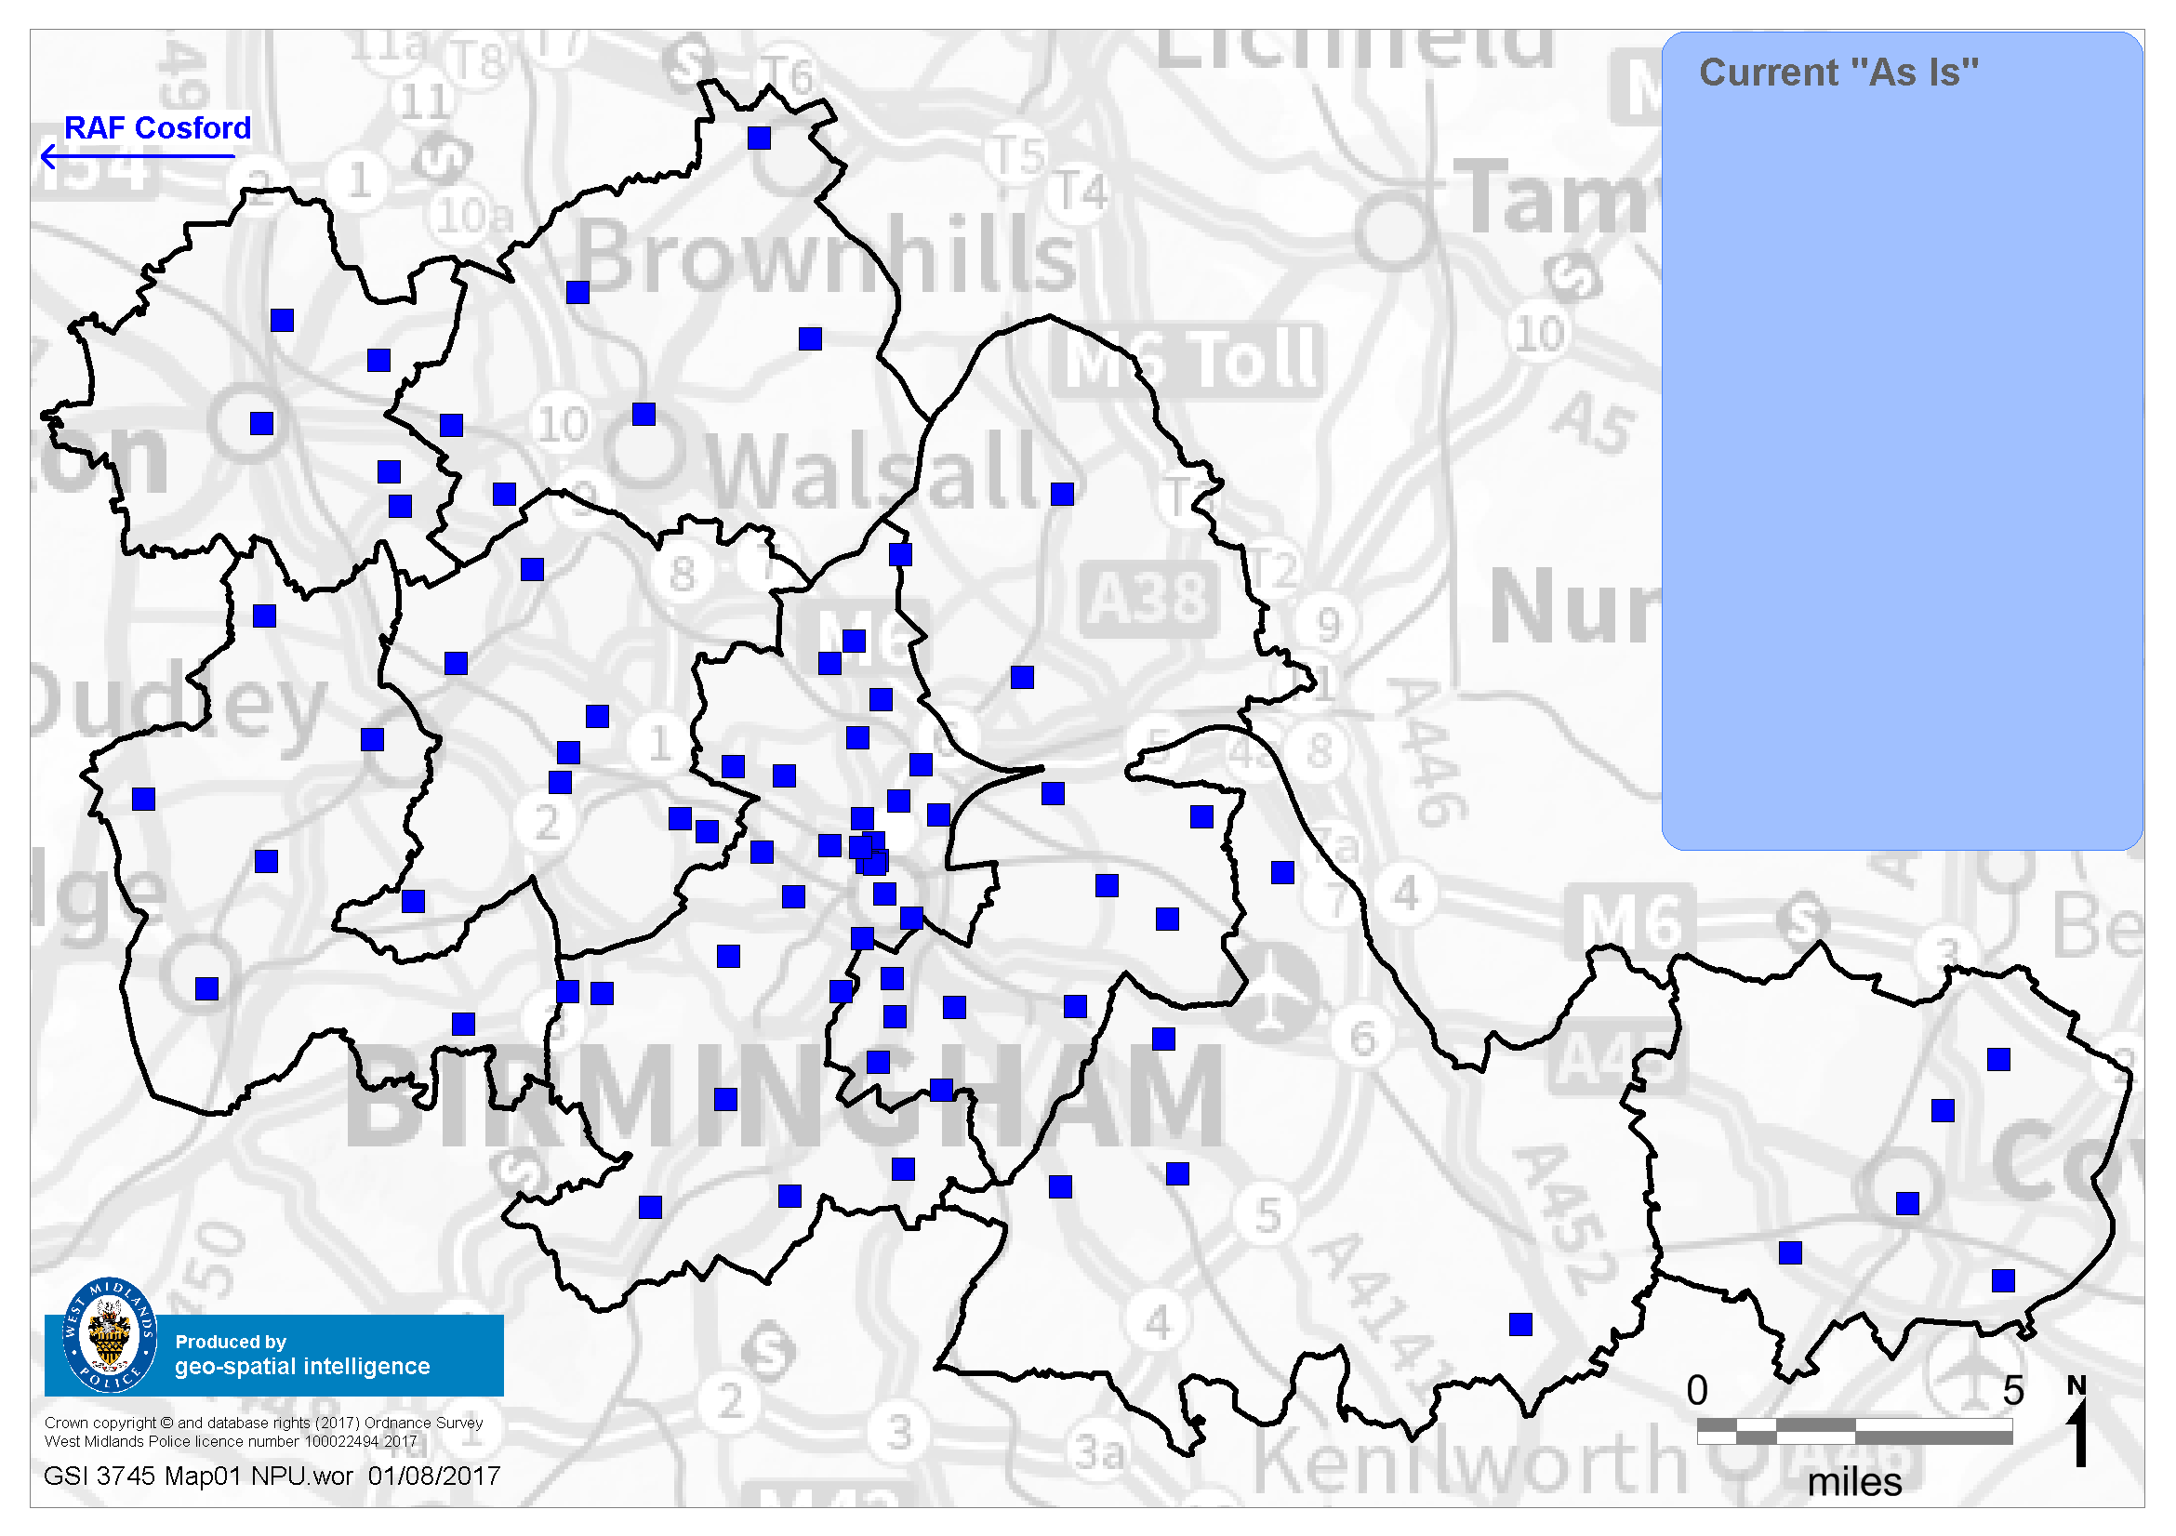
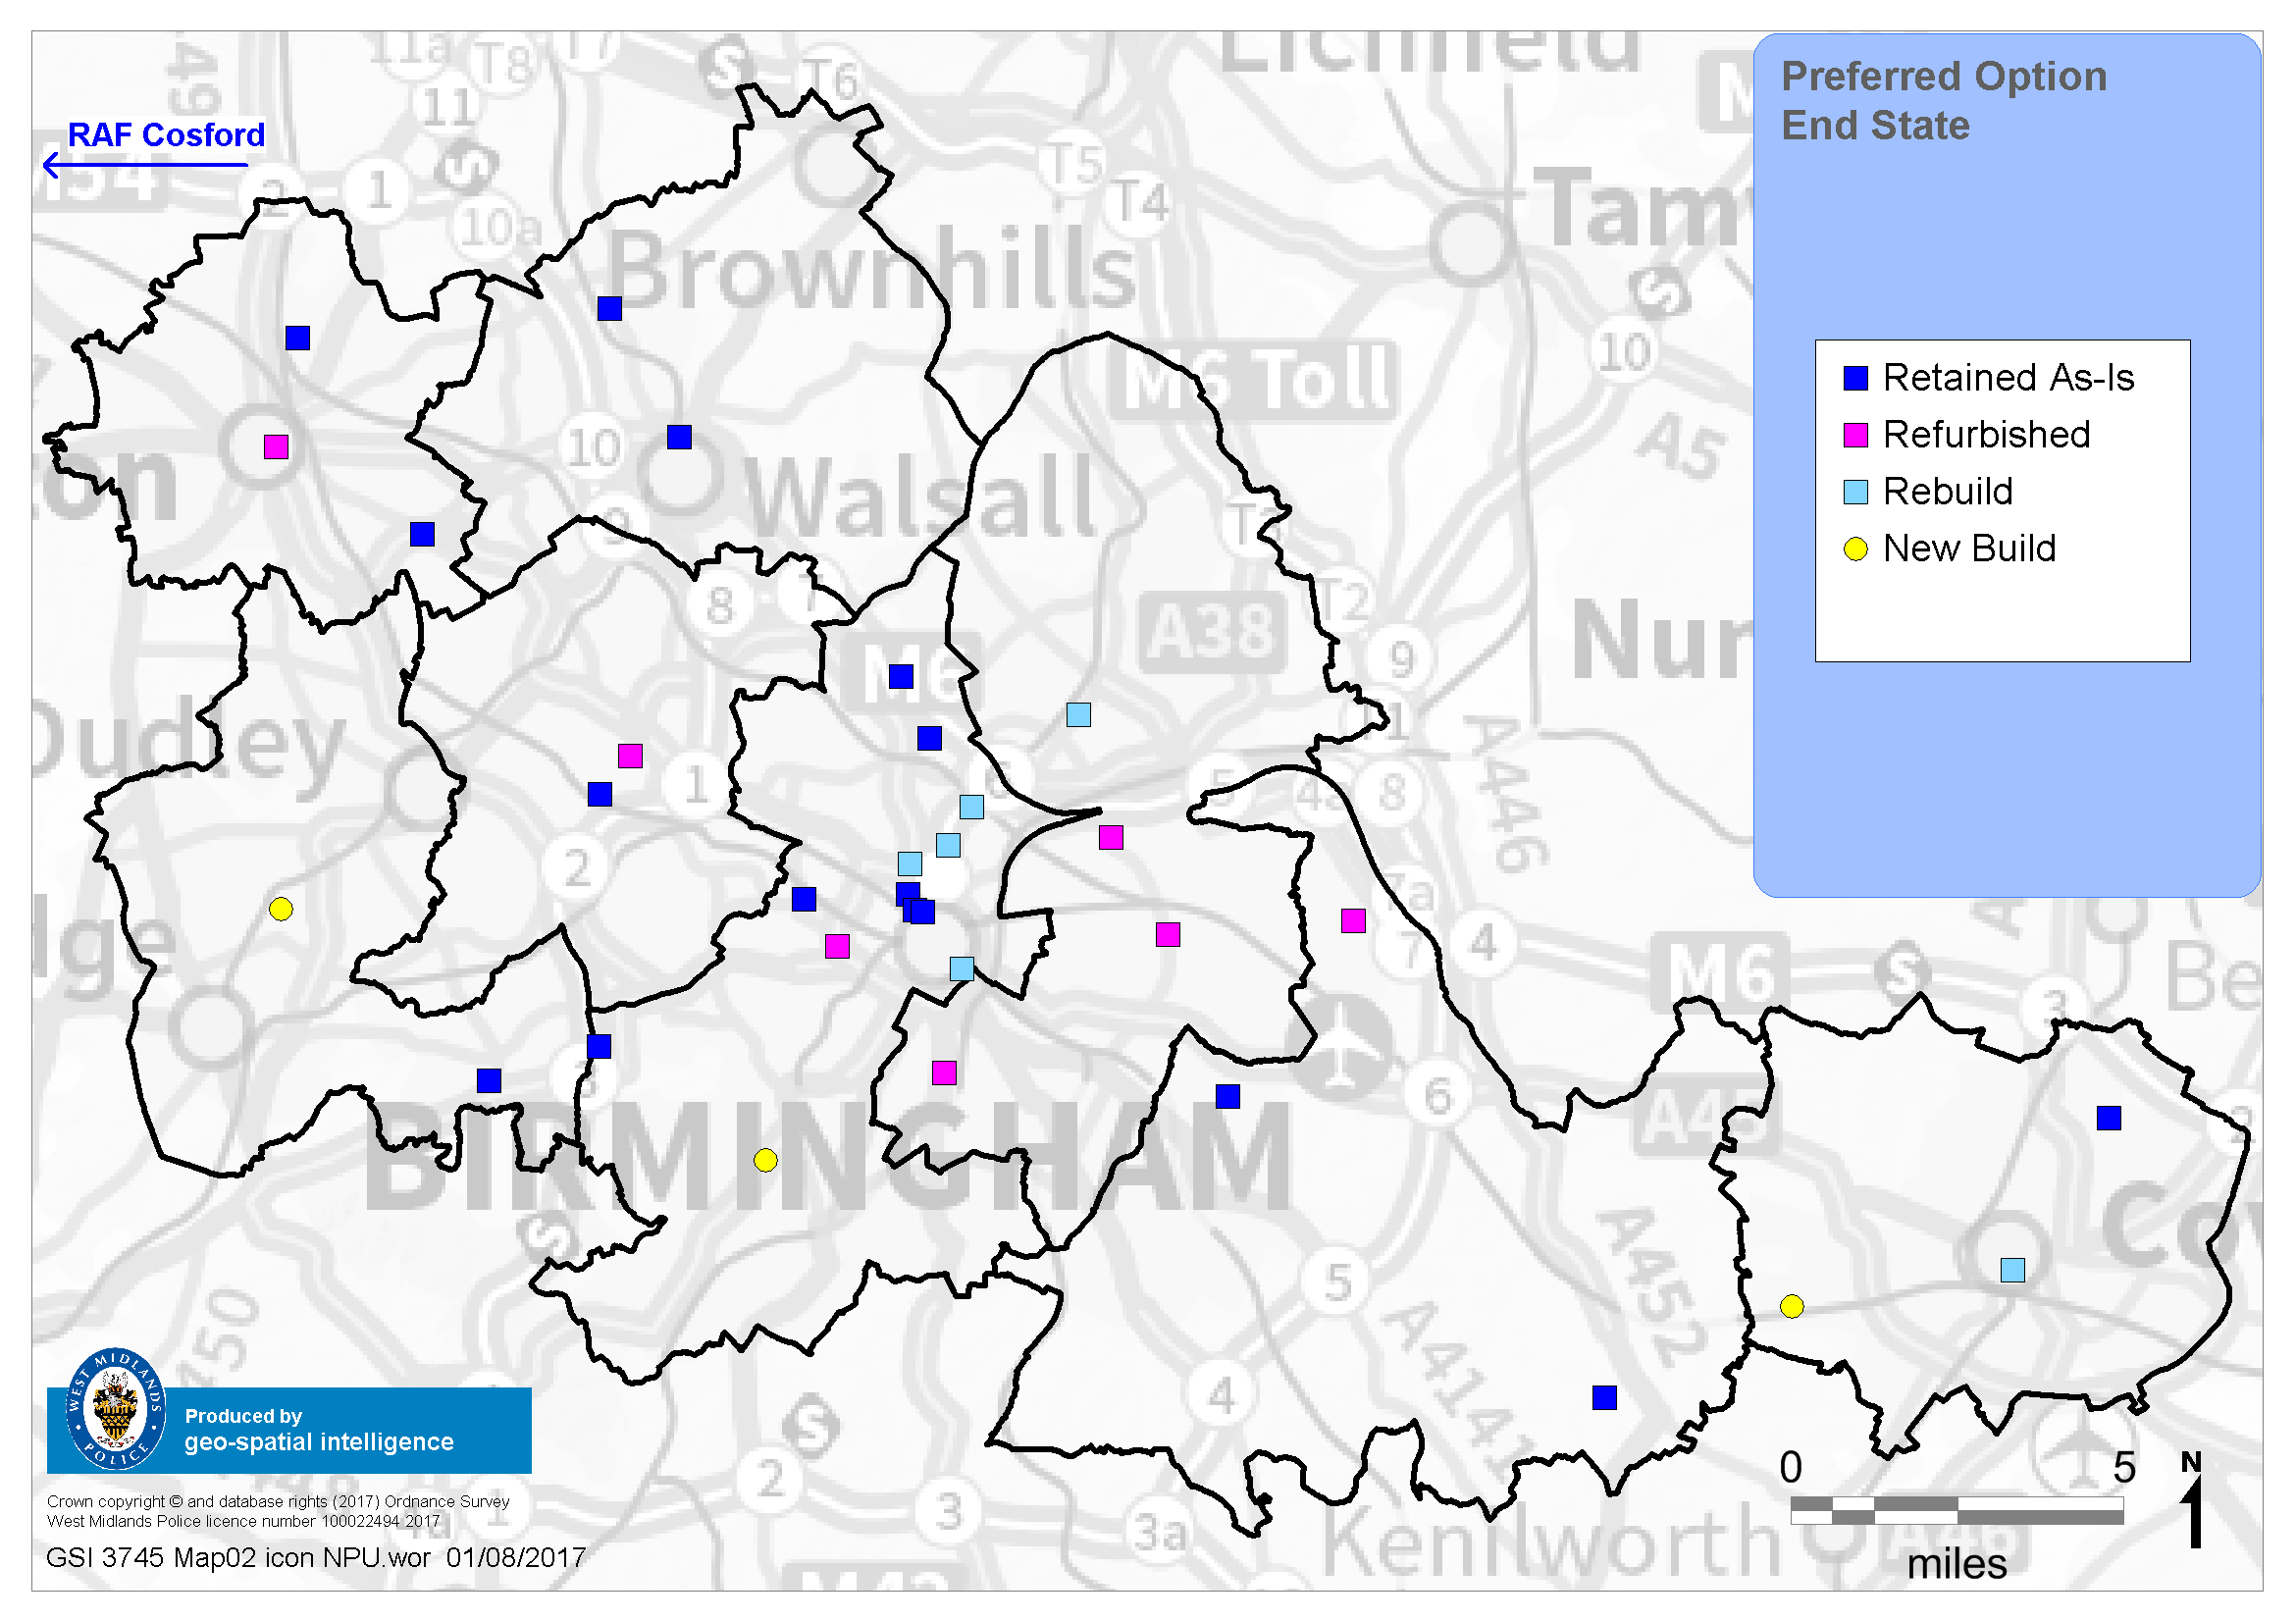
Estates Programme Geographical Representation
‘As is’ – WMP Freehold & Leasehold
End State inc. Custody – WMP Freehold only
Low Hill
Bloxwich
Sutton Coldfield
PCO re-provision
West Bromwich
Holford
Drive
Brierley Hill
Lloyd House
Stechford
Chelmsley Wood
Bournville
Solihull
Coventry Central
End state identifies WMP freehold properties only with the exception of Walsall Civic Centre. Excludes future partnership co-locations, opportunities to be explored following approval.

Slide 15
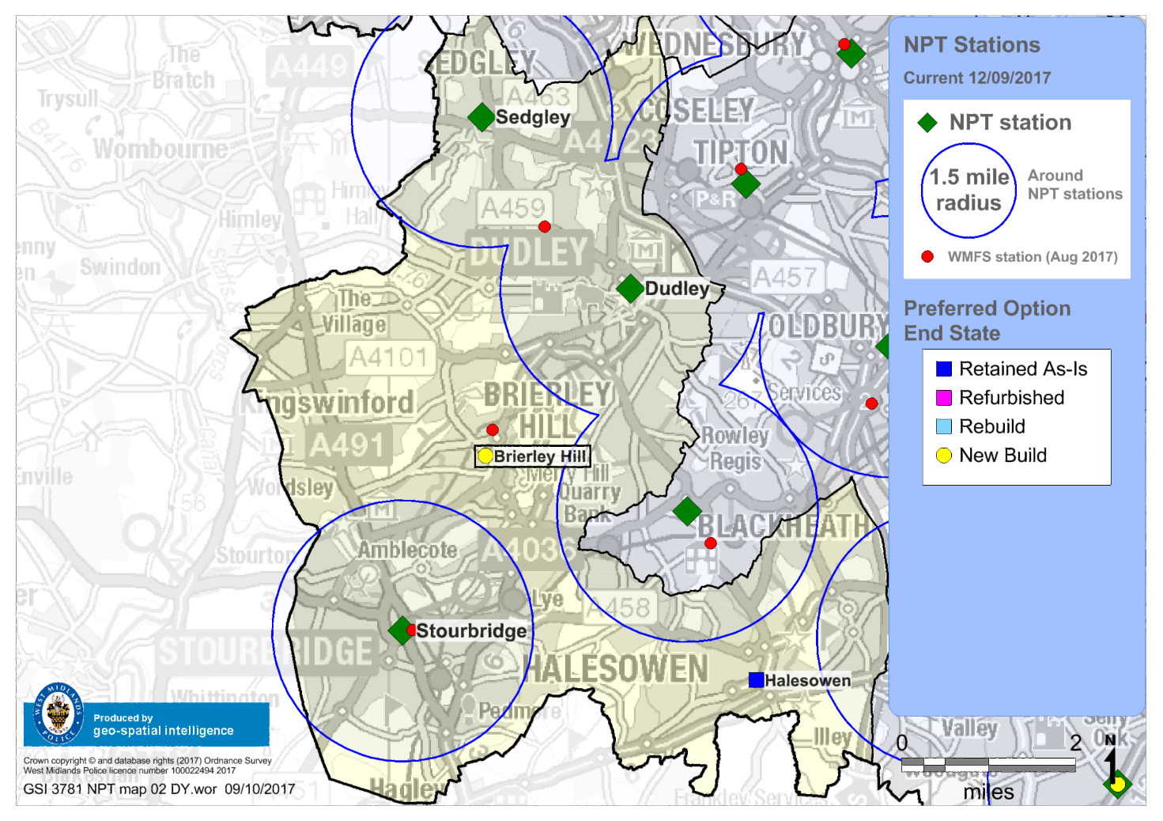
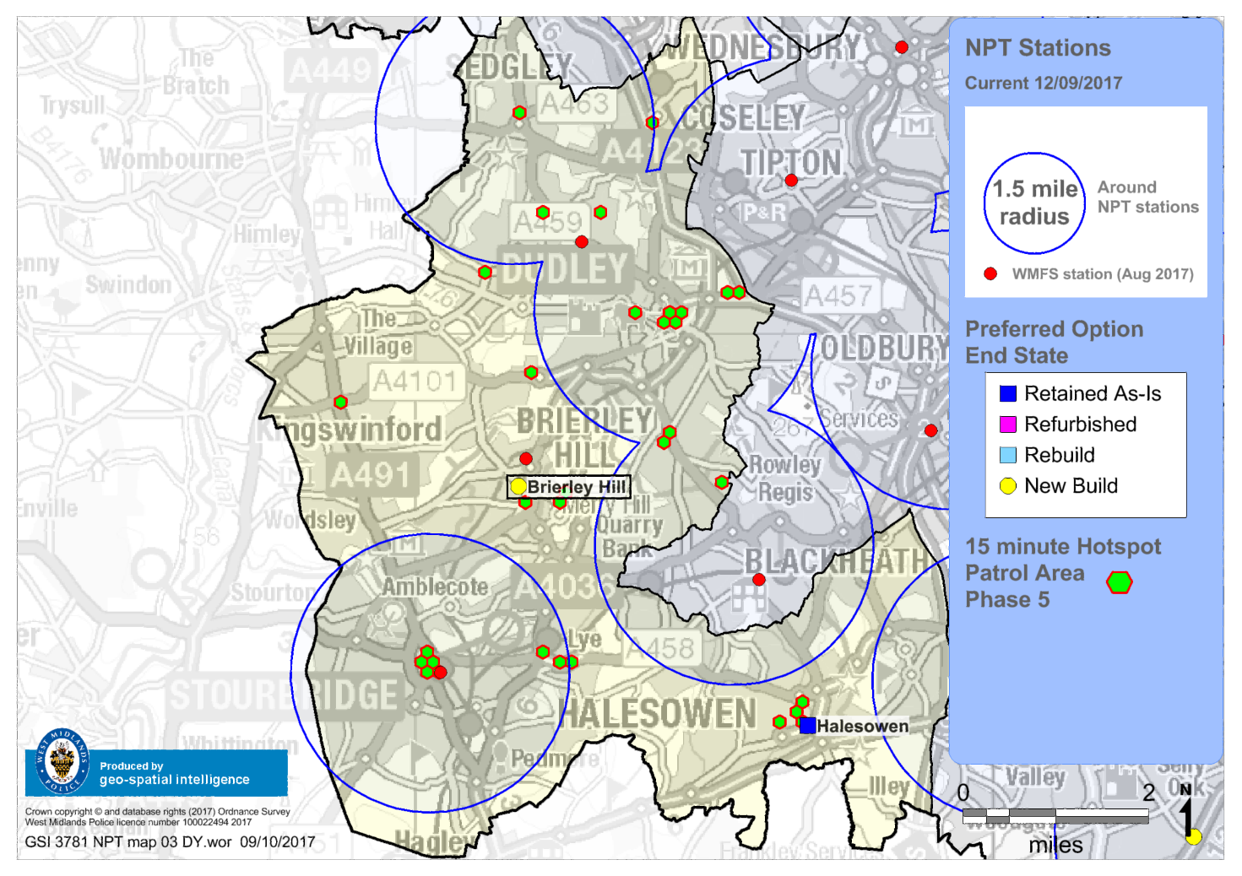
Estates Programme Geographical Representation DY – Partnership opportunities
Crime Hot Grids

Slide 16
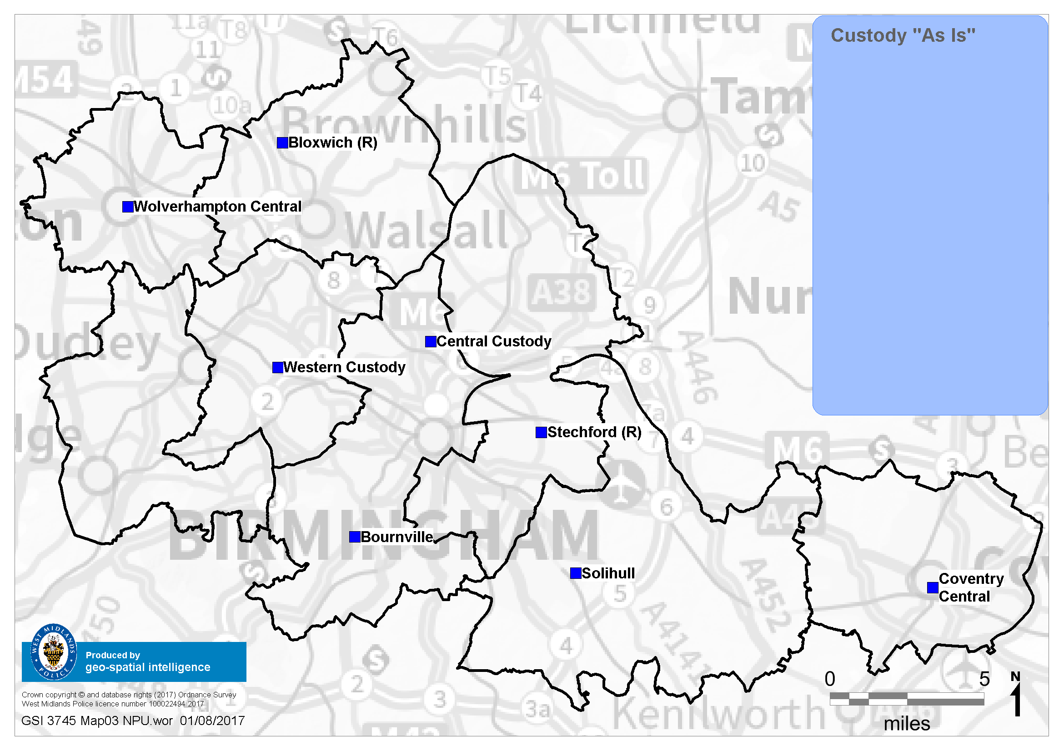
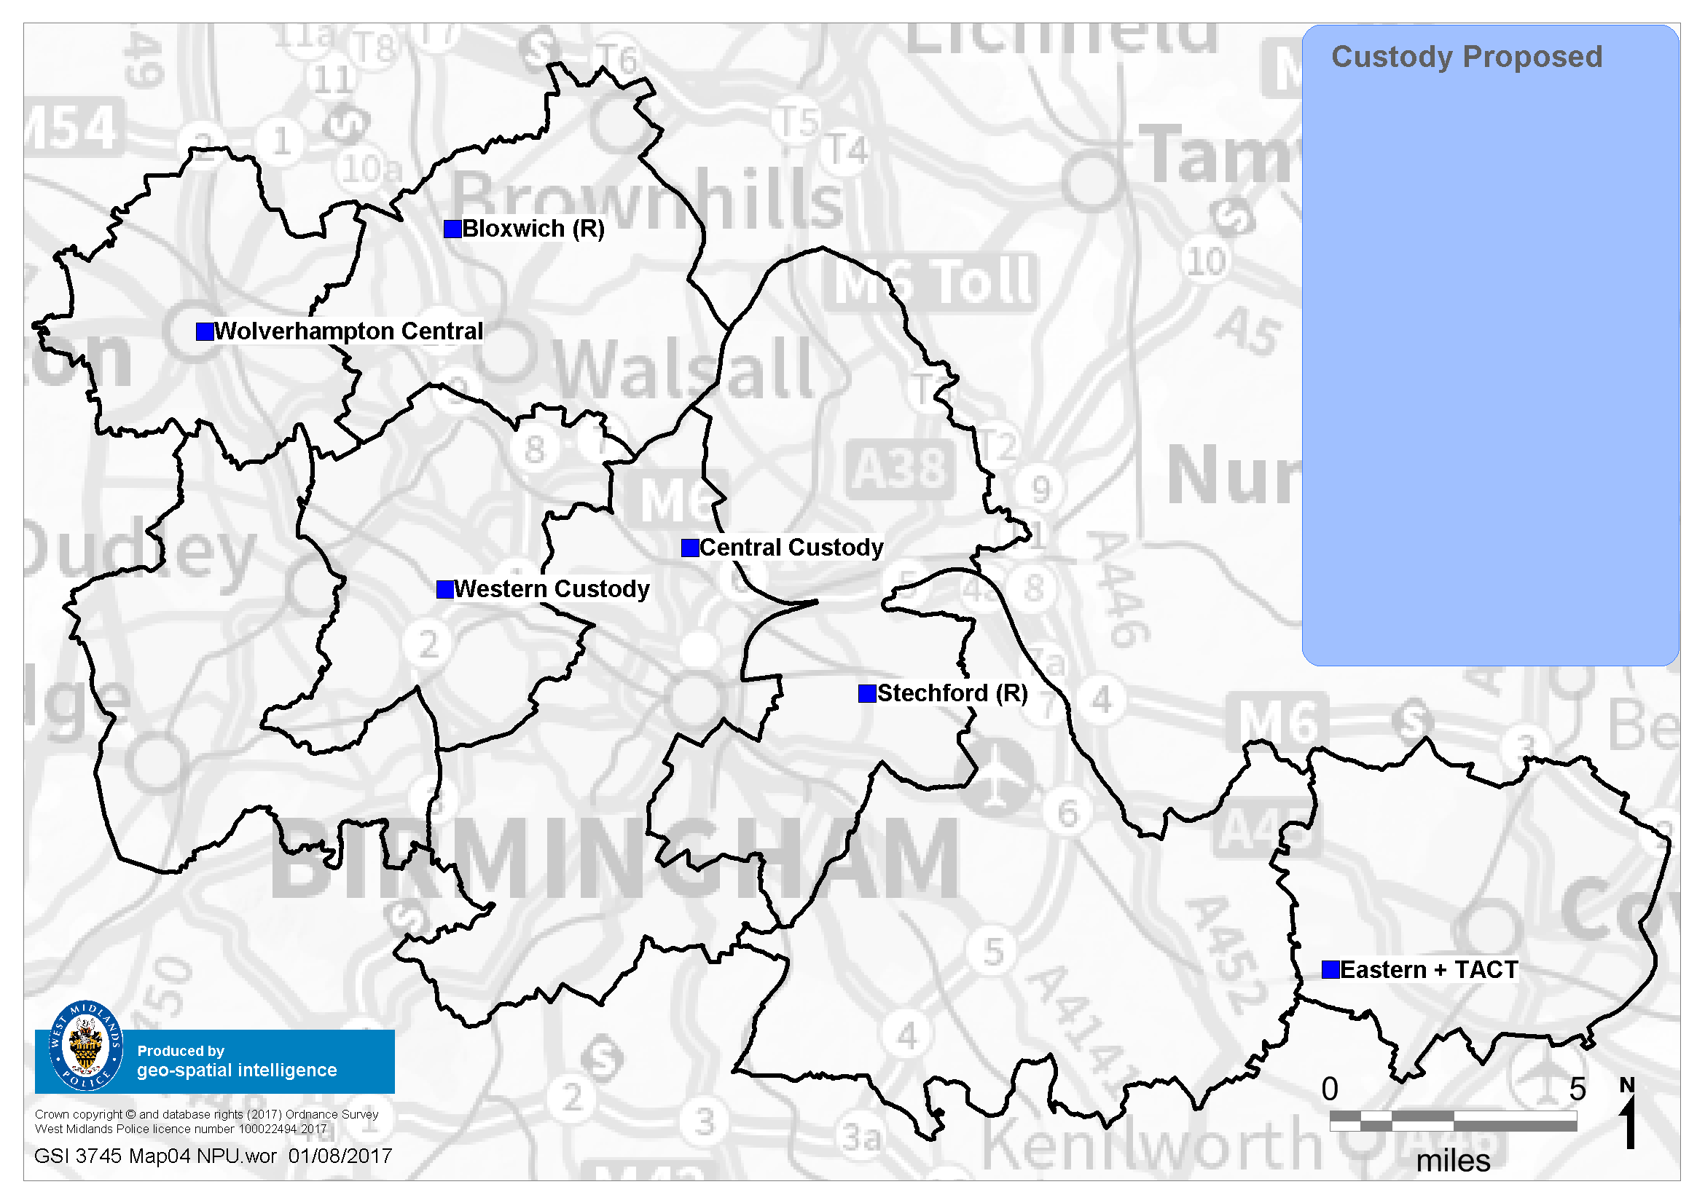
Estates Programme Geographical Representation
‘As is’ – Custody only
End state– Custody only
TACT

Slide 17
Estates Programme Remaining Rationalisation ‘35’
Buildings remaining for disposal under the Rationalisation Project after FY17/18 will move under the Estates Programme going forward. These will be built into the overarching Programme Business Case for Estates.
LPU | Property Name | Future state
BE | Billesley | Sell & re-provision
BE | Kings Heath* | Sell & re-provision
BE | Sparkhill* | Sell & re-provision
BW | Kings Norton inc. Annexe | Sell & re-provision
BW | Handsworth West | Sell & re-provision
DY | Dudley | Sell & re-provision
HQ | Windmill House* | Sell & re-provision
SW | Old Hill | Sell & re-provision
WS | Brownhills | Sell & re-provision
WS | Darlaston | Sell & re-provision
WS | Willenhall | Sell & re-provision
HQ | Halesowen* | Sell & re-provision
* Has been approved to retain until March 2019 following CR . This will be subject to review under the Estates Programme, could be used as a potential decant location throughout the programme lifecycle.

Slide 18
Estates Programme End State for Public Contact Offices & NPT’s
PORTFOLIO – LOCAL POLICING – ACC BOYCOTT
WMP will retain 10 Public Contact offices – 2 each for both Birmingham NPUs:
New locations
Wolverhampton Central (NWoW)
Bloxwich (as is)
Brierley Hill (new build)
West Bromwich (NWoW)
Lloyd House (as is)
Bournville Lane (new build)
Stechford (NWoW)
Sutton Coldfield partner (Re-provision)
Solihill partner (Re-provision)
Coventry Central (re-build)
It is assumed that 50% Officers and staff within NPTs will move into partnership buildings, e.g. WMFS, Las etc
Where the patrol area is within close proximity to one of WMPs core buildings, then that NPT would be based in that building
Other properties retained in addition to those above are in geographically advantageous locations and/or in high demand areas. These include Bilston (WV), Low Hill (WV), Moseley (BE), Bell Green (CV), Winchcombe Road (SH), Summerfield (BW), Walsall Civic Centre (WS)
Current location leases with Local Authorities/WMFS will be drawn up as formal agreements
NPTs based at Digbeth will be relocated into the new build at Bradford Street allowing for Digbeth’s disposal

