Slide 1
Estates Programme Update
SPCB
Oct’19

Slide 2
Agenda
Park Lane Phase 1:
  Progress update
Park Lane Phase 2:
  Progress update
Logistics Centre:
  Progress update
Enhancements:
  Progress update
Wider Programme updates:
  Acquisitions – Freehold & Leasehold
  Disposals
  Public Contact Offices inc. Stechford

Slide 3
Park Lane Phase 1 – Progress
WDC started construction programme
On site early and ground works progressing well and to schedule
Tower crane to be installed 19/20th October
Concrete frame of building to start 11th November
Target for completion of construction: Winter 2020
Operational testing from Spring 2021 to 2022 ahead of CWG2022
Key dependencies with Logistics and Park Lane Phase 2
Additional funding bid with CWG 2022 and ROCU in progress

Slide 4
Park Lane Phase 2
Park Lane Phase 1

Slide 5
Park Lane Phase 2 – Progress
Feasibility stage completed
Stage 3 workshops complete (stakeholders, SME’s and contractors)
Issue with storage for Block B (IT building and vehicle bay area) being explored
Impact upon cost and timeline to be agreed, design to then recommence
Stage 3 report due in November 2019 – Stage 4 to start immediately
Proposed start on site January 2020 with enabling works to be agreed
Proposal to agree contract sum February and sign delivery agreement March 2020

Slide 6
Logistics – Progress
Planning application for new site exit in progress
Garage workshop design agreed and supplier appointed
Bespoke storage solution design and specialist supplier agreed
Detailed floor plans developed in consultation with stakeholders
Detailed business readiness and relocation plans to be developed from Oct 19 onwards
Additional revenue benefit of £1.633m secured from re-negotiated Princip St lease
Sign off costs and enter into Delivery Agreement planned for Oct 19

Slide 7
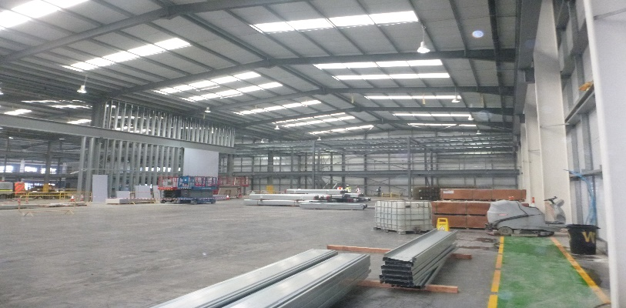
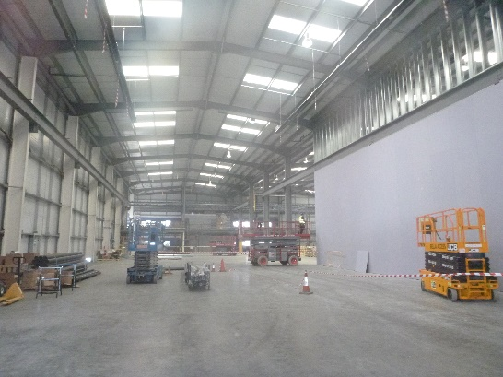
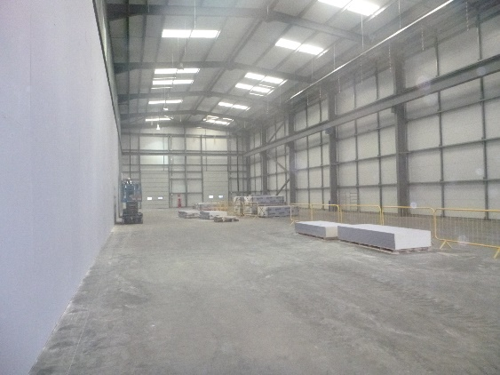
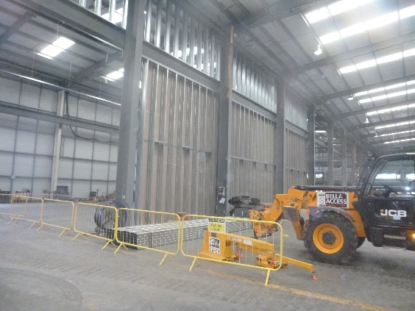
Logistics – On-site progress

Slide 8
Logistics – Overarching project timeline
Oct’19 – Construction commences (Post enabling works)
Jan’20- Feb’20 – Stakeholder NWoW sessions
Oct’19 – Sign off costs & Enter into wider delivery agreement
Jul’19 – Enabling works construction commences
Jul’19 - Enter into enabling works delivery agreement
Mar’19 - Detailed design developed
Jan’19 - Initial concept design commenced
Apr ’20 - WMP fit out complete
Mar ’20 - Construction complete
Nov’18 - Exchange of contracts
May’19 - Sign off detailed design
Apr ’20 - Occupation commences

Slide 9
Enhancements – Progress
Consists of 4 sites: Edgbaston, Moseley, Low Hill & Winchcombe Road
Stakeholder engagement to gather requirements completed
Initial concept designs developed and progressed into detailed & technical (D&T) design stage
Perfect Circle appointed to progress D & T designs
Further stakeholder engagement and business readiness activities undertaken
Currently working through final costs and detailed designs to inform final programme & costs
Sign off detailed design and costs Oct 19
Sign Delivery Agreements
Commence remaining decants, refurbishment and subsequent fit outs and repopulation for each site

Slide 10
Enhancements – Overarching project timeline
Initial 4 sites captured in timeline below:
Edgbaston
Winchcombe Rd
Low Hill
Moseley
May’ 19
Detailed design stage commences
Nov’19 - Jan’20
Refurbishments commences
Jan ’20
Decant Low Hill
Jun-Oct ’19
Sign off detailed design & costs
Jan ‘19 - Jun ’20
Refurbishments completed
Oct - Nov’19
Enter into delivery agreement/s
Mar’ 19
Initial concept designs complete
Dec ’19 – Jun ‘20
WMP fit out
Jan’19 - Jun ’20
Re-population
Remaining 4 sites to follow:
West Bromwich
Ridgepoint House
Summerfield
Bilston

Slide 11
Wider Programme updates
Acquisitions
Freehold & Leasehold
Public Contact Offices
Disposals

